Slide 1
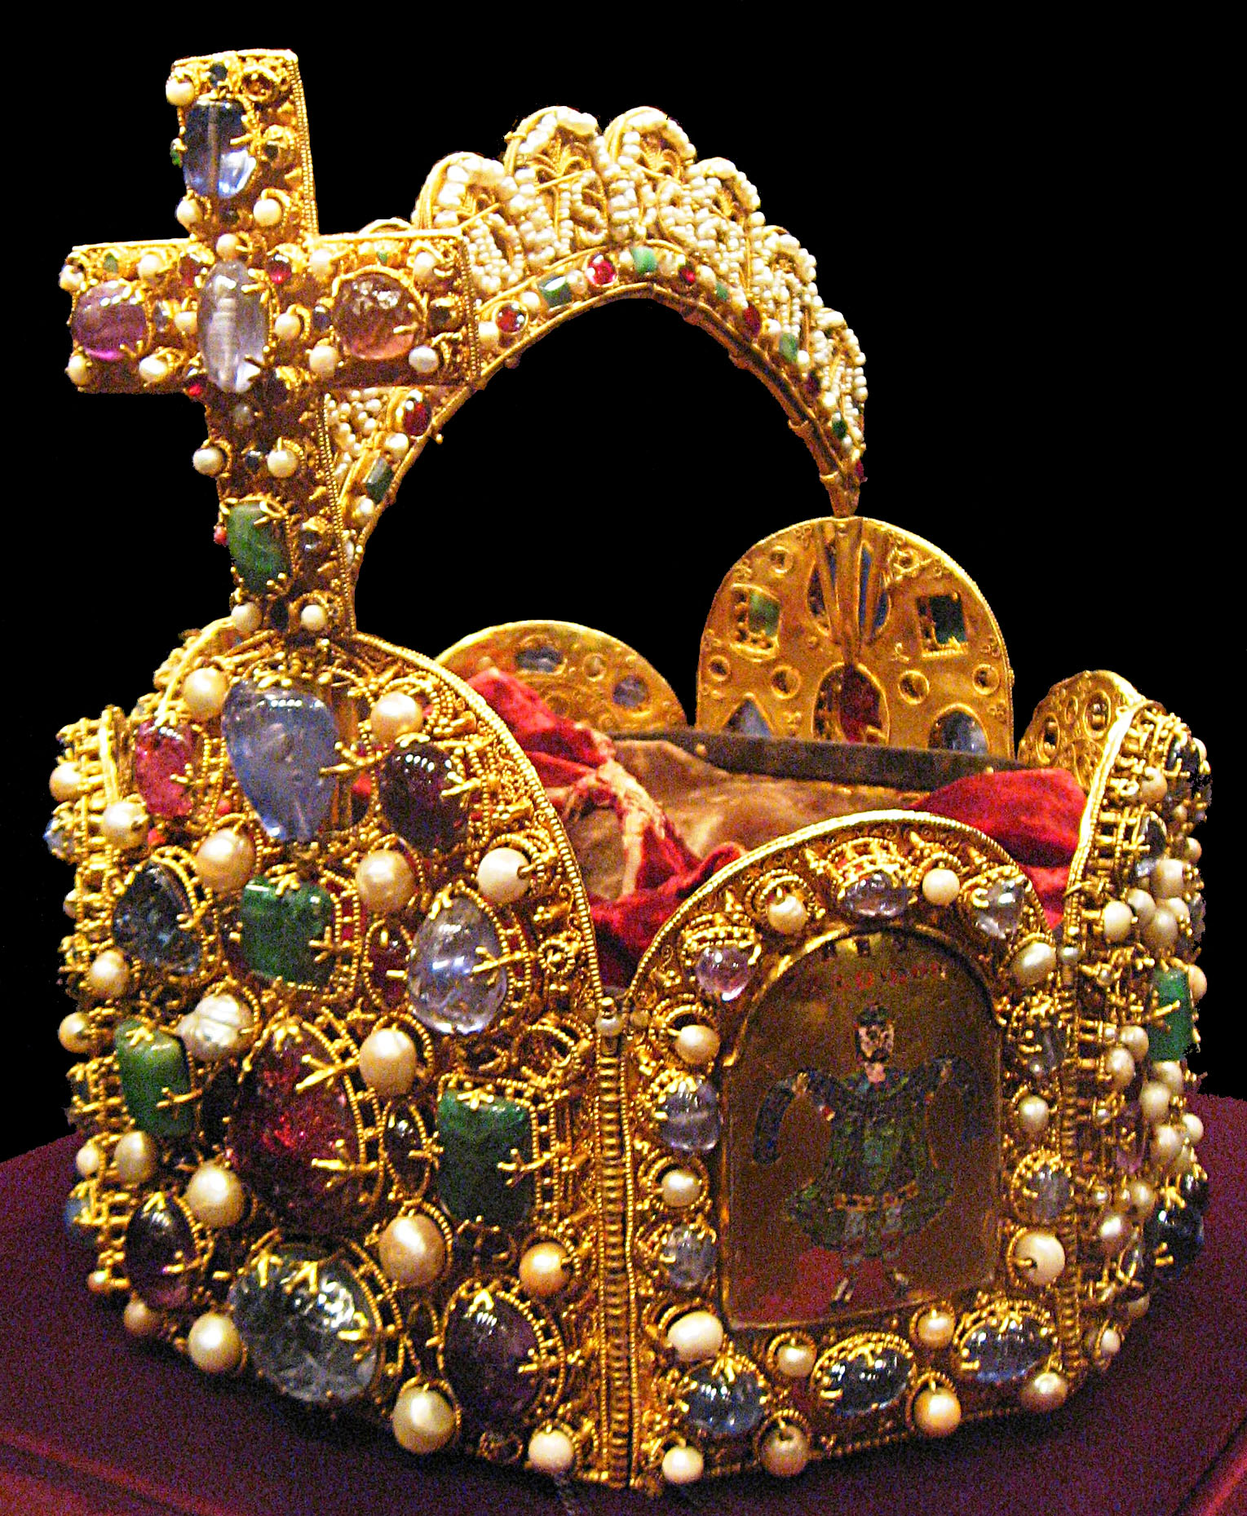
Dear VIS’s Parents,
we are glad to announce the first culture visit of the season that will take place at the Imperial Treasury Vienna, Kaiserliche Schatzkammer.
When: Wednesday September 26th at 11.00 am, until 13.00 pm.
Cost per person: 24€.
Meeting point: Hofburg, Schweizerhof, 1010 Wien in front of the museum.
The tour the Imperial Treasury is a chance to admire the most beautiful crown ever made, to explore the history of the mighty Habsburg dynasty, learn about the history of the Holy Roman Empire looking at the royal regalia, at the solid silver cradle of the king of Rome and the order of the Golden Fleece.
If you wish to attend, please register here: https://doodle.com/poll/tky5akcuy7zbzzac
IMPORTANT!
please kindly enter your name and surname followed by your email, in order to be reached for any further update;
only registrations on the above web site will be included and the criteria will be on first come, first served basis.
The event will be confirmed with minimum 15 attendees and we will be able to host maximum 25 people. When the maximum number of registered attendees is reached, the website will not allow you to register any more. Only in this case, please kindly send us an email to cultureclub@ptavis.com. We will be pleased to manage a waiting list and we will promptly inform you, if we can place your request.
Thank you!
Michela & Serena
Contacts:
cultureclub@ptavis.com

